Slide 1

NSTI Noida Team 01 [12 August,2024] Artificial Intelligence: Sign Language Gesture Recognition Team Name: Sign Sense Squad
Presented By:
1. Anshika Patel
2. Arvinder Singh
3. Jaspreet Kaur Gill
4. Tushar

Slide 2
Introduction
This project aims to develop a system that can accurately recognize and interpret sign language gestures, enabling communication between sign language users and non-sign language users.
The Sign Language Recognition project aimed to bridge communication gaps between the deaf community and the hearing population by leveraging advanced machine learning and computer vision techniques. Through meticulous research, development, and testing phases, the project has successfully demonstrated the feasibility and efficacy of using technology to interpret and translate sign language gestures into spoken or written language

Slide 3
Problem Statement
Sign language is a vital means of communication for the deaf and hard of hearing community. However, it can be a barrier for those who don't understand sign language.
The Social Challenge
The Technology Track

Slide 4
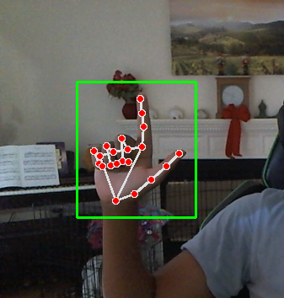
Project Overview
Our project uses computer vision and machine learning techniques to recognize sign language gestures. We've collected a dataset of sign language videos, preprocessed the data, and trained a CNN model to classify signs. The system can recognize signs with an accuracy.
The Sign Language Detection project utilizes Python and Artificial Intelligence (AI) to create a real-time system for interpreting sign language gestures. With a focus on accessibility and inclusivity, the project aims to overcome communication barriers faced by the Deaf and hard-of-hearing community.
Python's versatility is central to the project's development, leveraging libraries like Open CV, Tensor Flow, and Keras. These tools enable the creation of a robust model capable of processing video input, identifying hand gestures, and translating them into spoken or written language

Slide 5
Project Description
Frontend | Backend
A user-friendly website for sign language recognition would focus on accessibility, ease of use, and intuitive interaction | Setting real time hand gestures recognition system using webcam
It includes : Homepage, Project Plan, tutorials, Partners, Contact Us. | It captures video, process it , detect the algorithm & finally displays the output
Technologies used: HTML,CSS,JS | Technologies used: Python , open Cv, Media Pipe, Numpy, pickle
 | Process: Importing libraries, Load data Model, initialize video capturing, setup mediapipe, creating labels, Main loop, Process, Extract & Normalize, Predict & Display, Show frame, Release response.

Slide 6
Key Components-
Data Collection: We've collected a dataset of sign language videos from various sources.
Data Preprocessing: We've applied image processing techniques to enhance hand visibility and extracted features from the videos.
Model Training: We've trained a CNN model using the preprocessed data to recognize signs.
Testing: We've tested the system on new, unseen data to evaluate its performance.

Slide 7
Future Work
We plan to expand the dataset to include more signs, improve the model's accuracy, and integrate the system into a user-friendly application.
Sign Recognition Page:
Webcam Integration: A dedicated area where users can enable their webcam for real-time sign recognition.
Live Translation Display: A text box where recognized signs are translated into text, with options to convert the text to speech.
Gesture Tips: A sidebar offering tips on improving sign accuracy, such as hand positioning and camera angles.
Sign Library:
Searchable Database: A search bar at the top to quickly find signs by keyword.
Categorized Signs: Signs organized into categories like “Alphabet,” “Common Phrases,” and “Numbers.”
Video Thumbnails: Each sign entry includes a thumbnail video that plays the gesture when hovered over, along with a brief description.
User Profile and Dashboard:
Personalized Dashboard: Users can view their learning progress, saved signs, and recently practiced gestures.
Customization Options: Options to customize the user interface, such as theme colors, text size, and video playback speed.
Notifications: Alerts for new signs added to the library, progress milestones, and reminders for practice sessions.

Slide 8
Conclusion
Our sign language recognition project has the potential to bridge the communication gap between sign language users and non-sign language users. I believe this project can make a significant impact and I'm excited to continue working on it.

